Slide 1
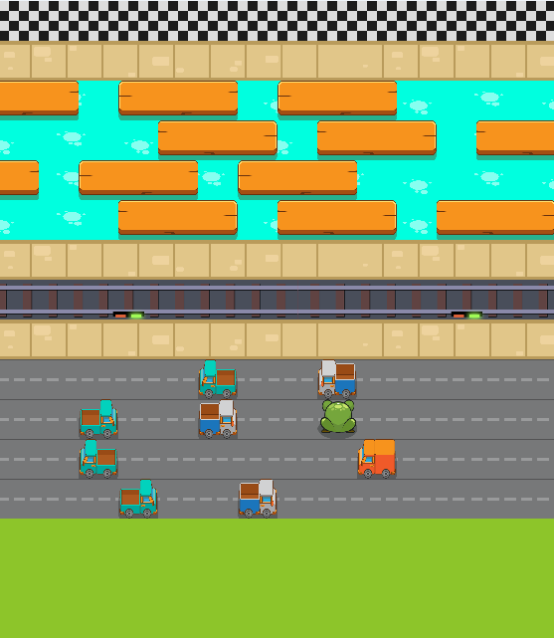
Defeating Frogger with AI
Omer Ferster
Tomer Meidan
Liel Amar

Slide 2
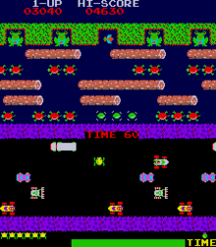
Introduction
Our project aimed to create AI agents that would beat a variation of the classic Frogger game. The goal is to get the frog to the finish-line while dodging obstacles.

Slide 3
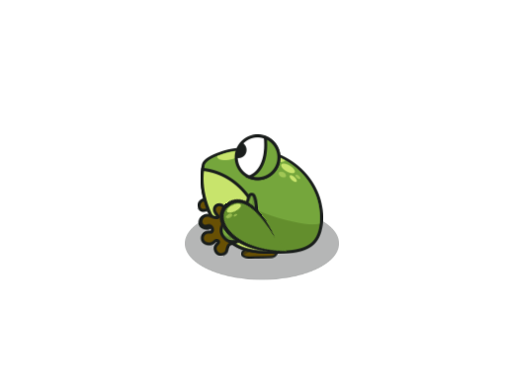
Why Frogger?
It’s a unique game we
loved playing growing up
The game is complex with more
states than atoms in the universe!
It’s an opportunity to use
state-of-the-art algorithms

Slide 4
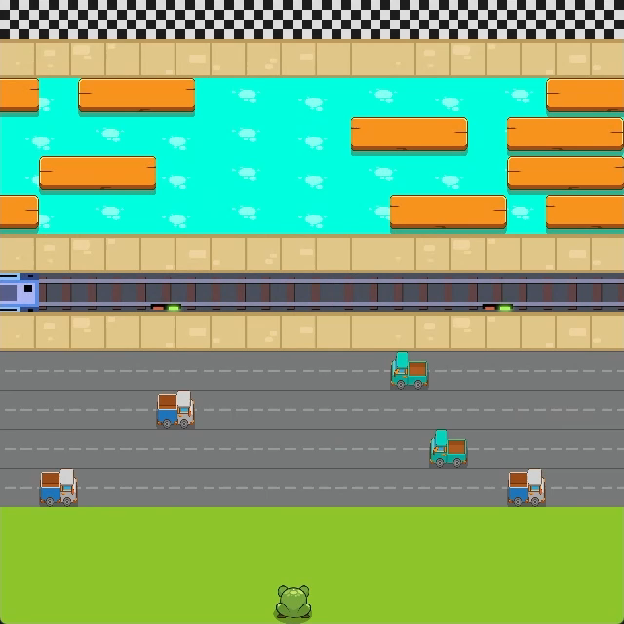

Gameplay
Grid-based
4 available actions
50 steps per game
3 difficulty levels

Slide 5
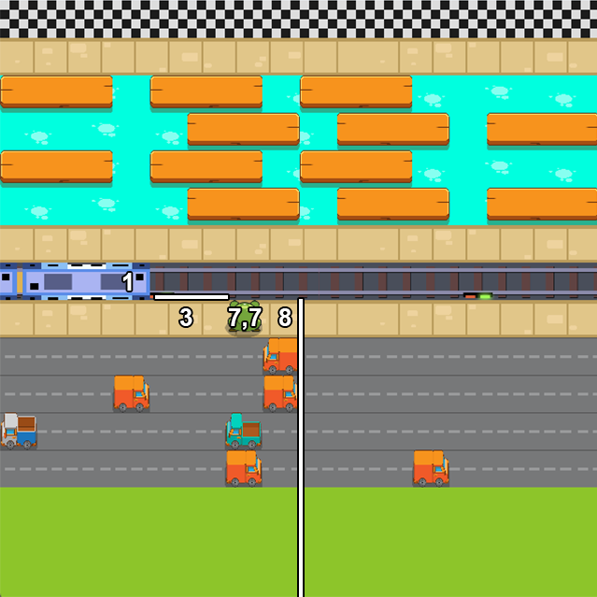
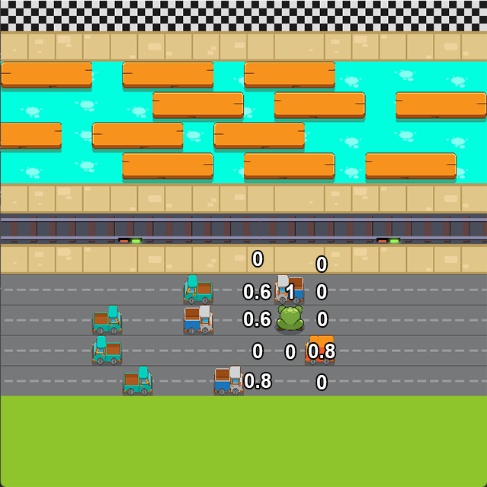
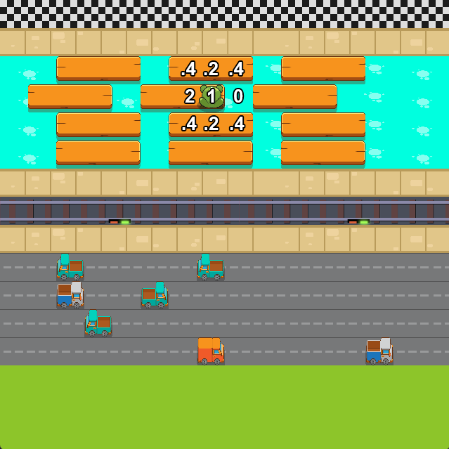
State Representation
We used the same state representation across all agents.
It includes at most 45 sensors for the different obstacles,
depending on the difficulty level.

Slide 6

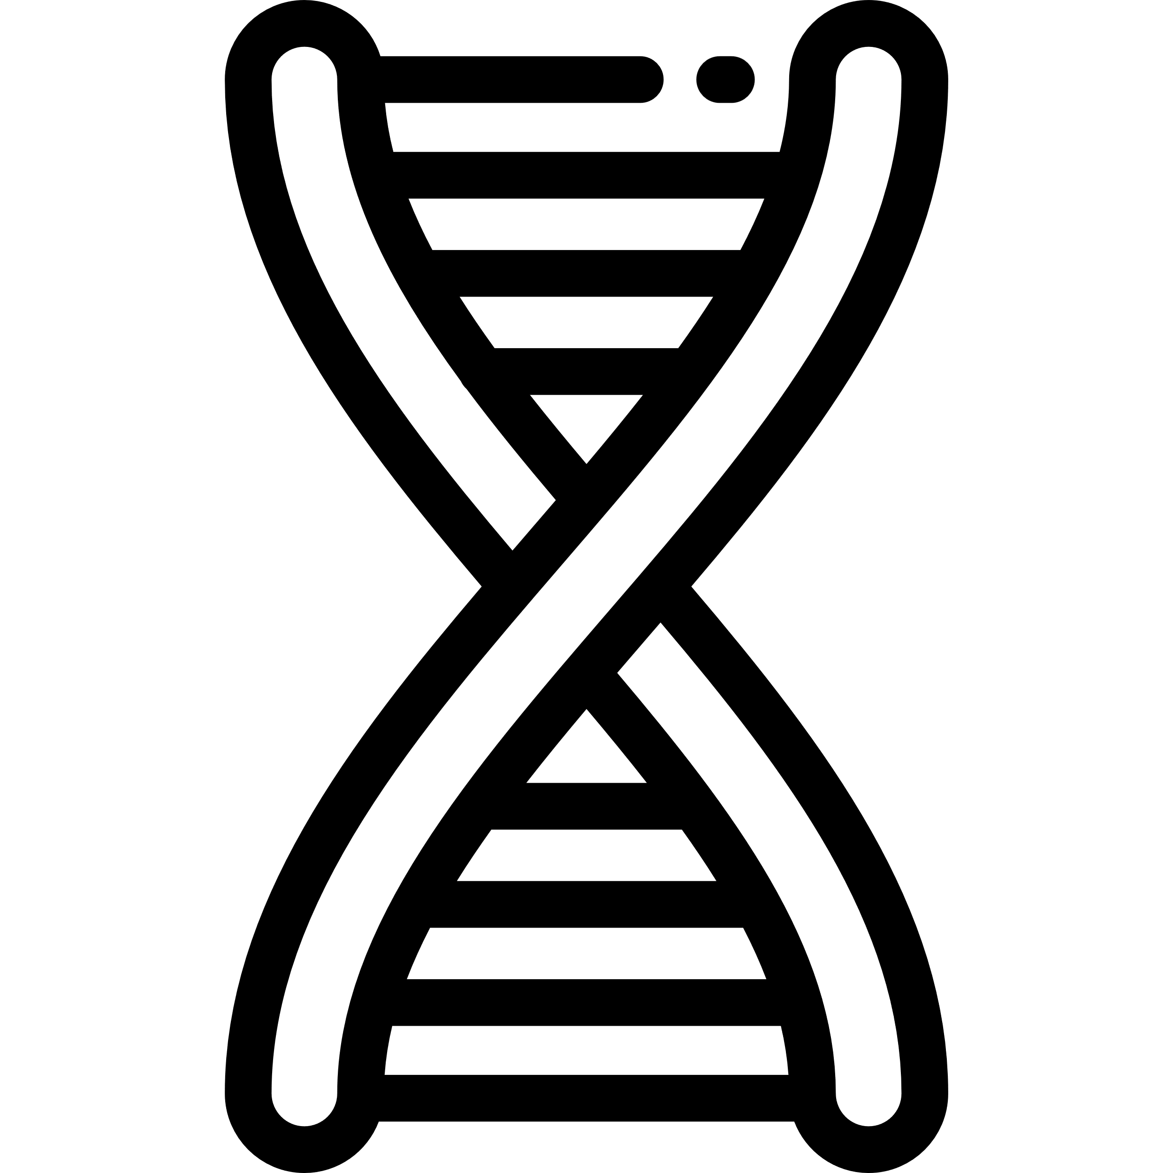


Our Agents
Double Deep
Q-Networks
NeuroEvolution of
Augmenting Topologies
(DDQN)
(NEAT)
Random Agent
Only-Up Agent

Slide 7
Our Agents
NeuroEvolution of
Augmenting Topologies
Double Deep Q-Networks
(DDQN)
(NEAT)
Baseline #1
Baseline #2
Random Agent
Only-Up Agent

Slide 8

Reward Mechanism
Our reward mechanism gives the agents
Positive Rewards
Negative Rewards
For taking actions which get them closer to the target
For taking actions which get them further away from the target

Slide 9
Reward Mechanism
Let’s further explore the reward and fitness functions!
DDQN Reward Function
NEAT Fitness Function
The DDQN agent receives a reward at every game frame:
A large reward if the agent won
Bonus for efficient solutions
A medium reward for beating personal best that game
A small reward for moving up
A large penalty if the agent died
A small penalty for sticking the either side of the screen
A small penalty for moving down
Every individual receives a reward at the end of each game:
A reward relative to progress made
Bonus for efficient solutions
A reward relative to number of unique steps taken

Slide 10
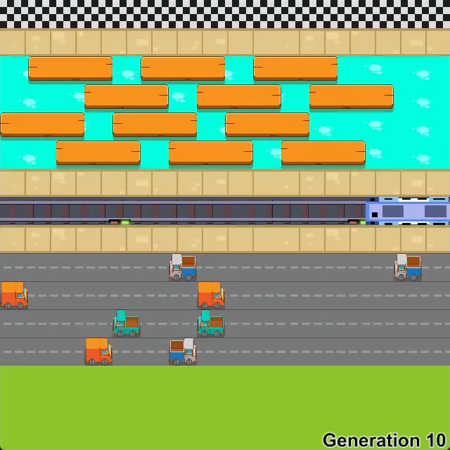
NEAT
NEAT is a genetic algorithm
We start with a population of 400 individuals
We want the best genes from each generation to remain
We encourage mutations and cross-over for exploration
In the end, we pick the best solution evaluated by a fitness function

Slide 11
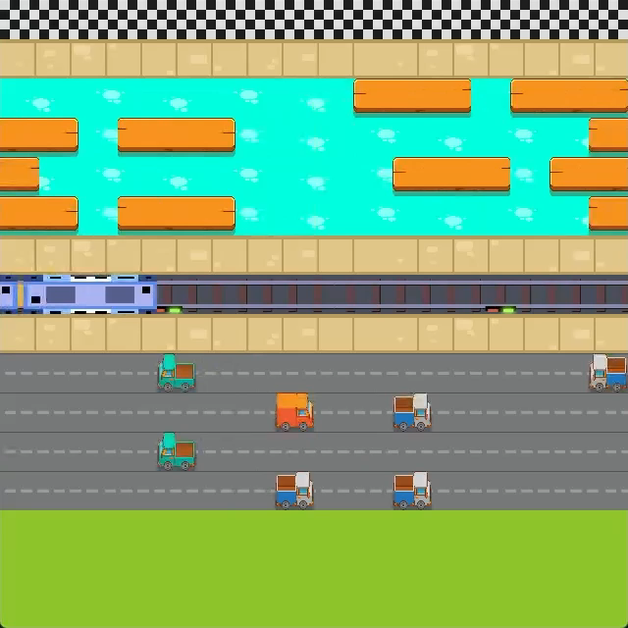
DDQN
DDQN is a reinforcement learning algorithm
It aims to find an optimal action selection policy, by estimating Q-Values
It does so by using 2 identical neural networks, which update during training
It is more suitable for this problem, compared to standard DQN, by reducing the over-estimation of Q-Values

Slide 12
Evaluating the Agents
We used 3 metrics to evaluate our models
Win Rate
The percentage of wins out of 100
Solution Efficiency
Average number of remaining steps after each win
Convergence Time
Time taken each model to converge to the optimal reward

Slide 13
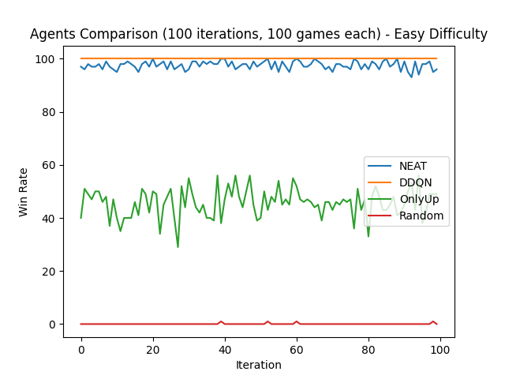
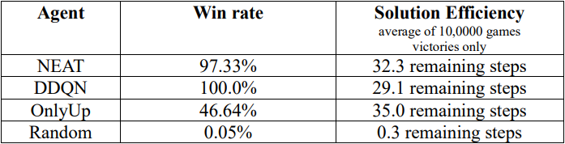
Results – Experiment #1 (Easy Difficulty)
Win Rate
Solution Efficiency

Slide 14
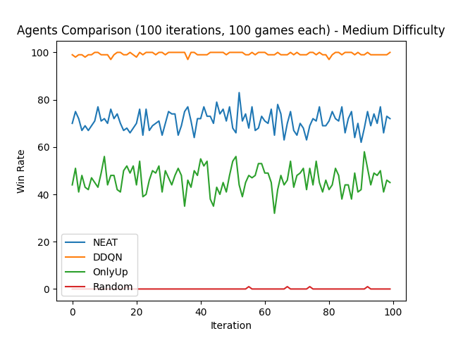
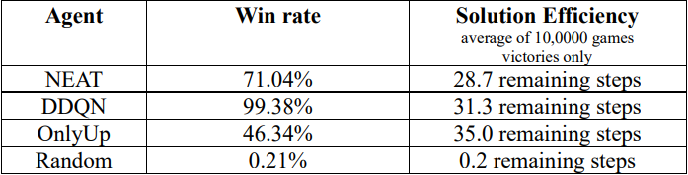
Results – Experiment #2 (Medium Difficulty)
Win Rate
Solution Efficiency

Slide 15
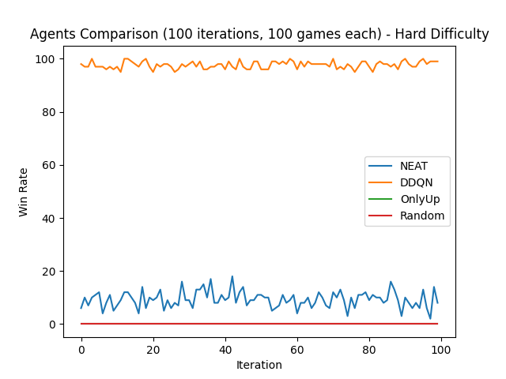
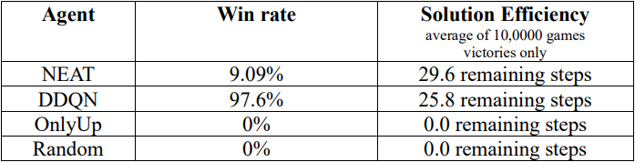
Results – Experiment #3 (Hard Difficulty)
Win Rate
Solution Efficiency

Slide 16
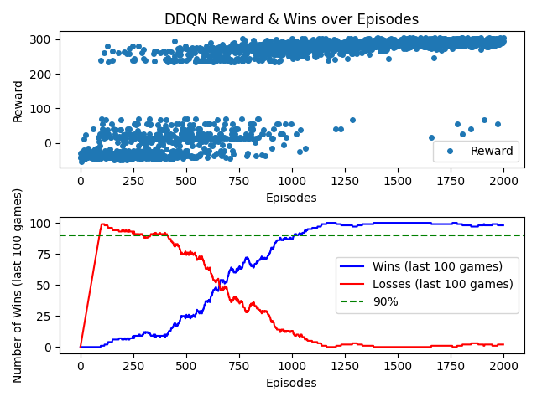
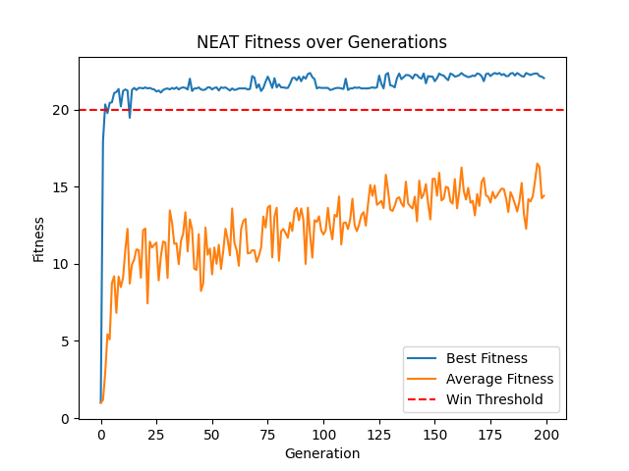
Convergence Time Easy Difficulty
DDQN
NEAT

Slide 17
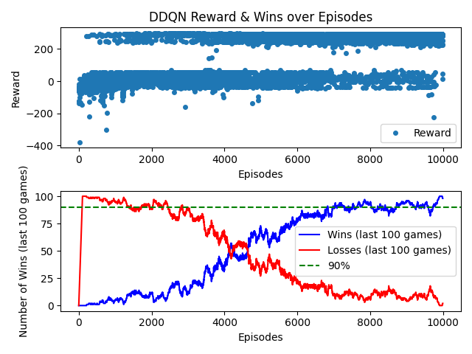
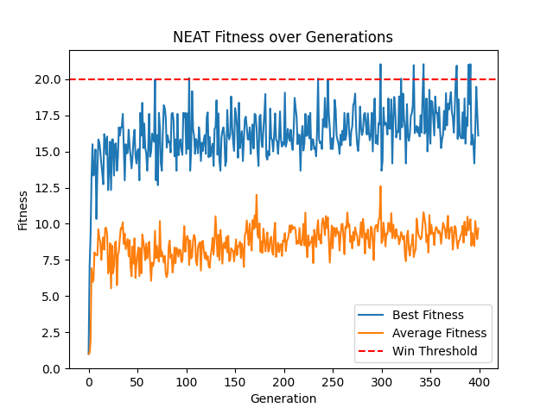
Convergence Time Hard Difficulty
DDQN
NEAT

Slide 18
DDQN vs NEAT gameplay – Hard Difficulty

Slide 19
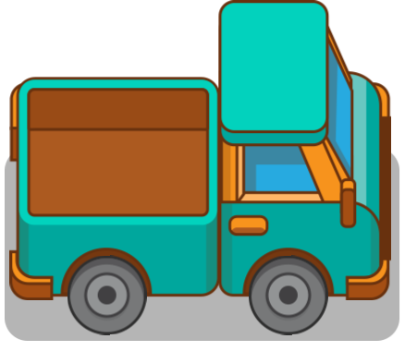

Summary
What did we try to solve?
DDQN DOMINATING THE GAME
Creating AI Agents that would navigate
A finite world to a predefined target
How did we do it?
We used two algorithms – NEAT and DDQN.
We then compared the results using 3 metrics.
What were the results?
DDQN dominated all experiments, whereas
NEAT was faster to converge in the easier tasks.

